Slide 1
Lecture 11 - Culture
Managing Business

Slide 2
Learning Outcomes
At the end of the lecture, you should be able to:
  Describe the seven dimensions of organisational culture.
  Discuss the impact of a strong culture on organisations and managers.
  Explain the source of an organisation’s culture.
  Describe how culture is transmitted to employees.
  Describe how culture affects managers.

Slide 3

The Organisation’s Culture
Organisational Culture
  A system of shared meanings and common beliefs held by organisational members that determines, in a large degree, how they act towards each other.
  “The way we do things around here.”
    Values, symbols, rituals, myths, and practices
  Implications:
    Culture is a perception.
    Culture is shared.
    Culture is descriptive.

Slide 4
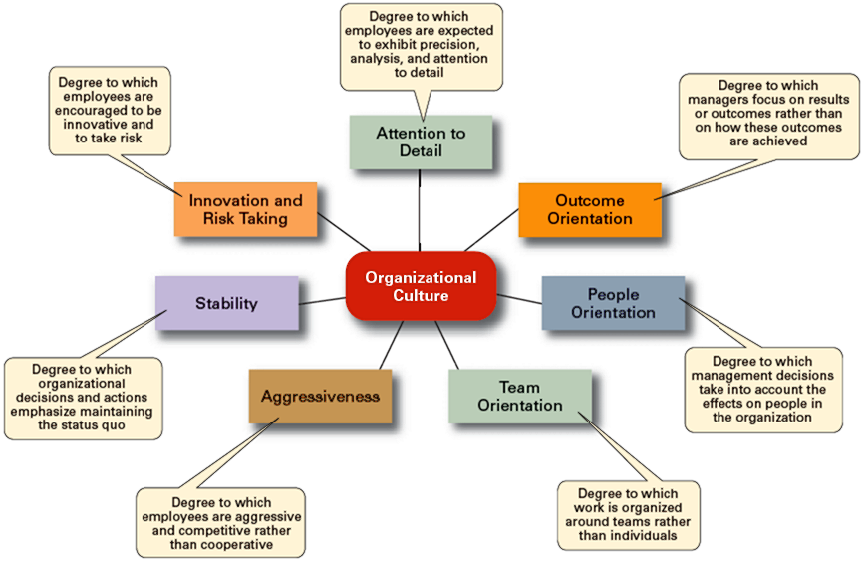
Seven Dimensions of Organisational Culture

Slide 5
Contrasting Organisational Cultures
Dimension | Organisation A | Organisation B
Attention to Detail | High | Low
Outcome Orientation | Low | High
People Orientation | Low | High
Team Orientation | Low | High
Aggressiveness | Low | High
Stability | High | Low
Innovation and Risk Taking | Low | High

Slide 6
Strong versus Weak Cultures
Strong Cultures
  Are cultures in which key values are deeply held and widely held.
  Have a strong influence on organisational members.
Factors Influencing the Strength of Culture
  Size of the organisation
  Age of the organisation
  Rate of employee turnover
  Strength of the original culture
  Clarity of cultural values and beliefs

Slide 7

Benefits of a Strong Culture
Creates a stronger employee commitment to the organisation.
Aids in the recruitment and socialisation of new employees.
Fosters higher organisational
performance by instilling and
promoting employee initiative.

Slide 8
Organisational Culture
Sources of Organisational Culture
  The organisation’s founder
    Vision and mission
  Past practices of the organisation
    The way things have been done
  The behavior of top management
Continuation of the Organisational Culture
  Recruitment of like-minded employees who “fit”
  Socialisation of new employees to help them adapt to the culture

Slide 9
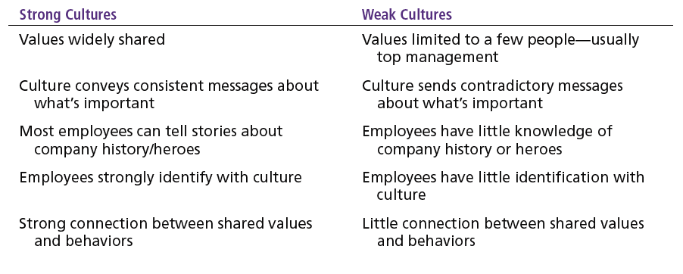
Strong versus Weak Organisational Cultures

Slide 10
How Employees Learn Culture
Stories
  Narratives of significant events or actions of people that convey the spirit of the organisation
Rituals
  Repetitive sequences of activities that express and reinforce the values of the organisation
Material Symbols
  Physical assets distinguishing the organisation
Language
  Acronyms and jargon of terms, phrases, and word meanings specific to an organisation

Slide 11
How Culture Affects Managers
Cultural Constraints on Managers
  Whatever managerial actions the organisation recognises as proper or improper on its behalf
  Whatever organisational activities the organisation values and encourages
  The overall strength or weakness of the organisational culture
  Simple rule for getting ahead in an organisation:
  Find out what the organisation rewards and do those things.

Slide 12
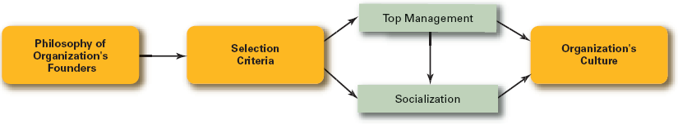
How an Organisation’s Culture Is Established and Maintained

Slide 13
Managerial Decisions Affected by Culture
Planning
  The degree of risk that plans should contain
  Whether plans should be developed by individuals or teams
  The degree of environmental scanning in which management will engage
Organising
  How much autonomy should be designed into employees’ jobs
  Whether tasks should be done by individuals or in teams
  The degree to which department managers interact with each other

Slide 14
Managerial Decisions Affected by Culture (cont’d)
Leading
  The degree to which managers are concerned with increasing employee job satisfaction
  What leadership styles are appropriate
  Whether all disagreements—even constructive ones—should be eliminated
Controlling
  Whether to impose external controls or to allow employees to control their own actions
  What criteria should be emphasised in employee performance evaluations
  What repercussions will occur from exceeding one’s budget

Slide 15
Organisation Culture Issues
Creating an Ethical Culture
  High in risk tolerance
  Low to moderate aggressiveness
  Focus on means as well as outcomes
Creating an Innovative Culture
  Challenge and involvement
  Freedom
  Trust and openness
  Idea time
  Playfulness/humor
  Conflict resolution
  Debates
  Risk-taking

Slide 16
Suggestions for Managers: Creating a More Ethical Culture
Be a visible role model.
Communicate ethical expectations.
Provide ethics training.
Visibly reward ethical acts and punish unethical ones.
Provide protective mechanisms so employees can discuss ethical dilemmas and report unethical behavior without fear.

Slide 17
Organisation Culture Issues (cont’d)
Creating a Customer-Responsive Culture
  Hiring the right type of employees (ones with a strong interest in serving customers)
  Having few rigid rules, procedures, and regulations
  Using widespread empowerment of employees
  Having good listening skills in relating to customers’ messages
  Providing role clarity to employees to reduce ambiguity and conflict and increase job satisfaction
  Having conscientious, caring employees willing to take initiative

Slide 18
Suggestions for Managers: Creating a More Customer-Responsive Culture
Hire service-contact people with the personality and attitudes consistent with customer service—friendliness, enthusiasm, attentiveness, patience, concern about others, and listening skills.
Train customer service people continuously by focusing on improving product knowledge, active listening, showing patience, and displaying emotions.
Socialise new service-contact people to the organisation’s goals and values.
Design customer-service jobs so that employees have as much control as necessary to satisfy customers.
Empower service-contact employees with the discretion to make day-to-day decisions on job-related activities.
As the leader, convey a customer-focused vision and demonstrate through decisions and actions the commitment to customers.

Slide 19
Summary of Main Teaching Points
Describe the seven dimensions of organisational culture.
Explain the source of an organisation’s culture and how that culture continues.
Discuss how culture is transmitted to employees.

Slide 20
Question and Answer Session
Q & A

Slide 21
Next Session
Topic and Structure of next session
NEXT LESSON:
Communications in Organisations

